Slide 1
Chemistry – Jan 30, 2020
Do Now– Complete the District Unit 3 Chapter 1, Atomic Structure and Radioactivity Activity
Objective –
  Chemical Bonding
Assignment:
  Study for Polyatomic ion practice quiz on Tues
Agenda
  District Activity
  Polyatomic ions

Slide 2
Polyatomic Ions
Two or more atoms form a group that has a collective charge.
Memorize the polyatomic ions (see next slide).
  Make flash cards. Seriously.
NEVER change the formula of a polyatomic ion
  Imagine a shrink-wrap packaging goes around the number and types of atoms and you cannot break up this bundle

Slide 3
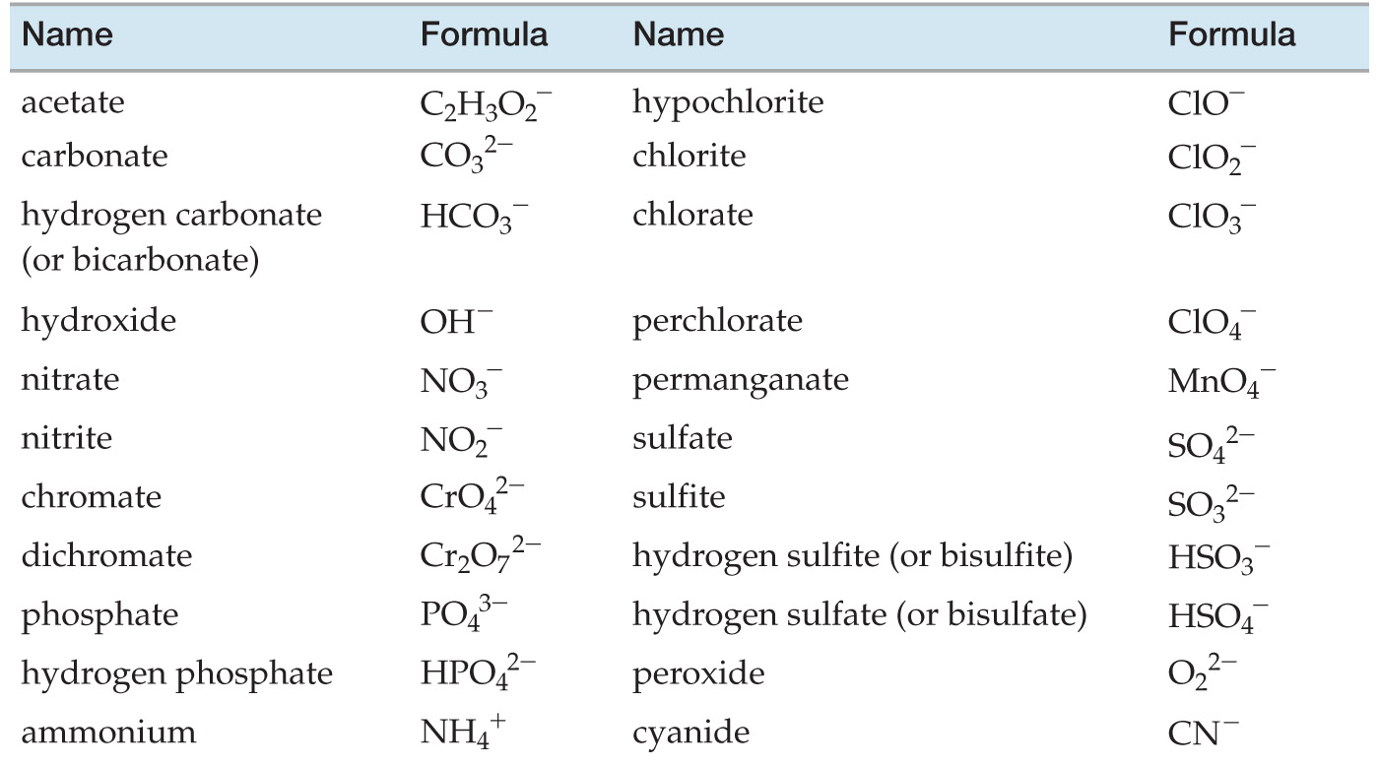

Slide 4
Exit Slip - Homework
Exit Slip: a) What is the hydroxide ion? b) What is the nitrite ion? c) What is NH₄⁺ ?
  (try from memory first)
What’s Due? (Pending assignments to complete.)
  Study for Polyatomic ion quiz on Tuesday. Practice quiz tomorrow.
What’s Next? (How to prepare for the next day)
  Read p194-198

